Slide 1
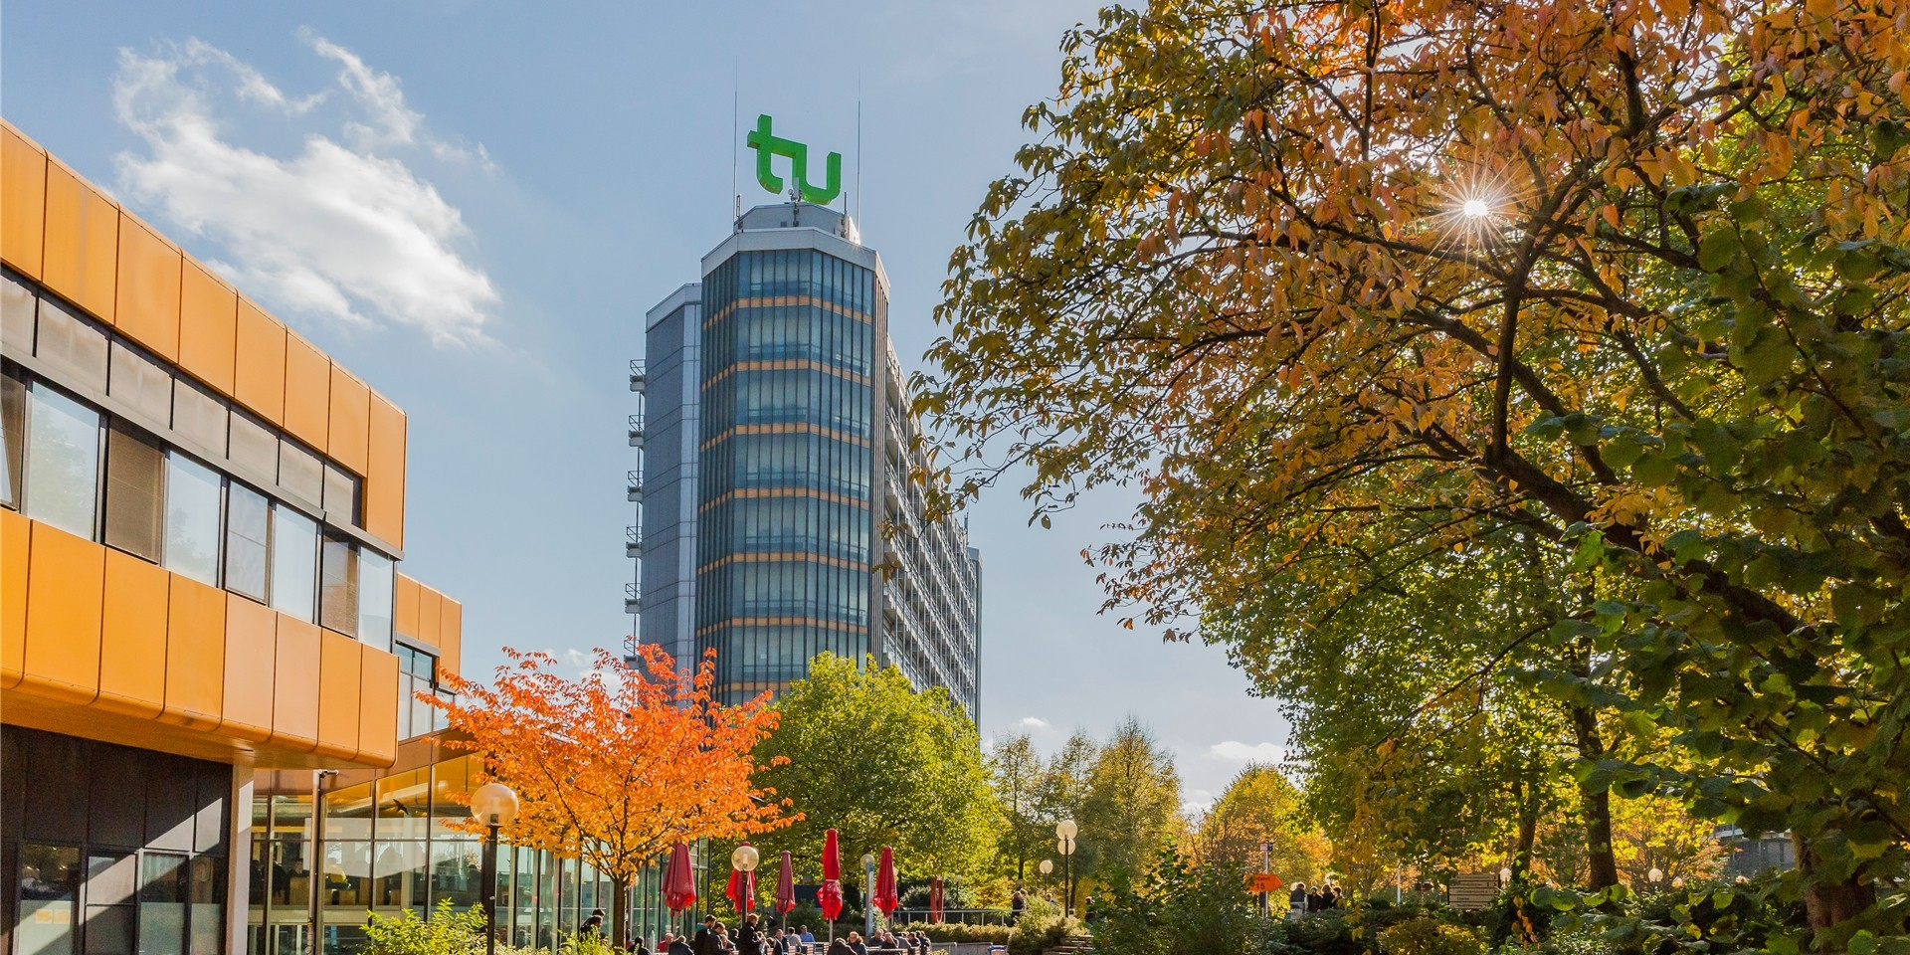
G1: Autoregressive Models Conclusion

Slide 2
Motivation for autoregressive models
Goal: estimate underlying distribution of data
Predict future values in sequential data by using past values (autoregression)

Slide 3
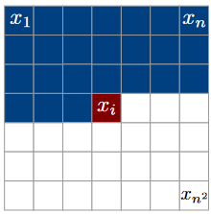
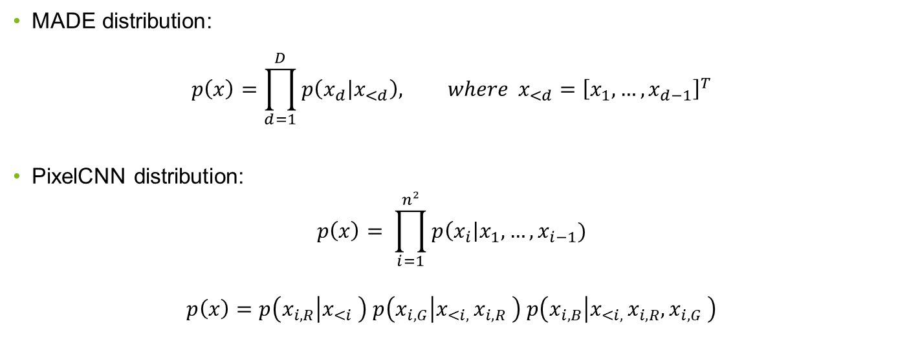
MADE vs PixelCNN: Distribution
MADE distribution:
$$p\left(x\right)=\prod_{d=1}^{D}{p\left(\left.x_{d}\right|x_{<d}\right), where }x_{<d}={\left[x_{1},…,x_{d−1}\right]}^{T}$$
PixelCNN distribution:
$$p\left(x\right)= \prod_{i=1}^{n²}{p\left(x_{i}\right|x_{1},…,x_{i−1})}$$
$$p\left(x\right)=p\left(x_{i,R} | x_{<i} \right) p\left(x_{i,G} | x_{<i, }x_{i,R} \right) p\left(x_{i,B} | x_{<i, }x_{i,R},x_{i,G} \right)$$
Notes:
Main Disadvantage: The representation it learns can be trivial
if the hidden layer is at least as large as the input, hidden units can each learn to “copy” a single input dimension

Slide 4
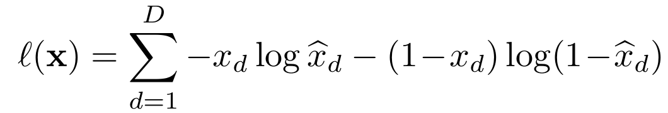
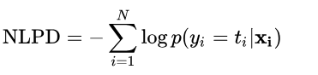
MADE vs PixelCNN: Loss
MADE uses the cross-entropy loss
PixelCNN uses negative log likelihood
Notes:
Main Disadvantage: The representation it learns can be trivial
if the hidden layer is at least as large as the input, hidden units can each learn to “copy” a single input dimension

Slide 5
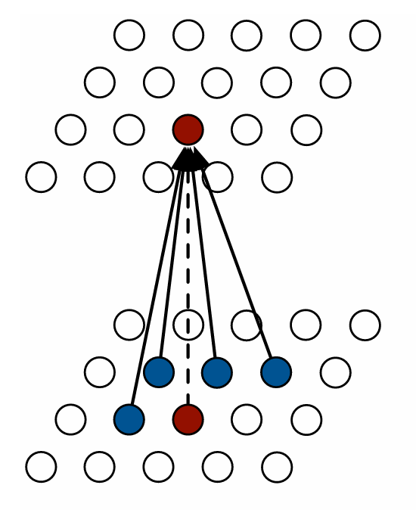
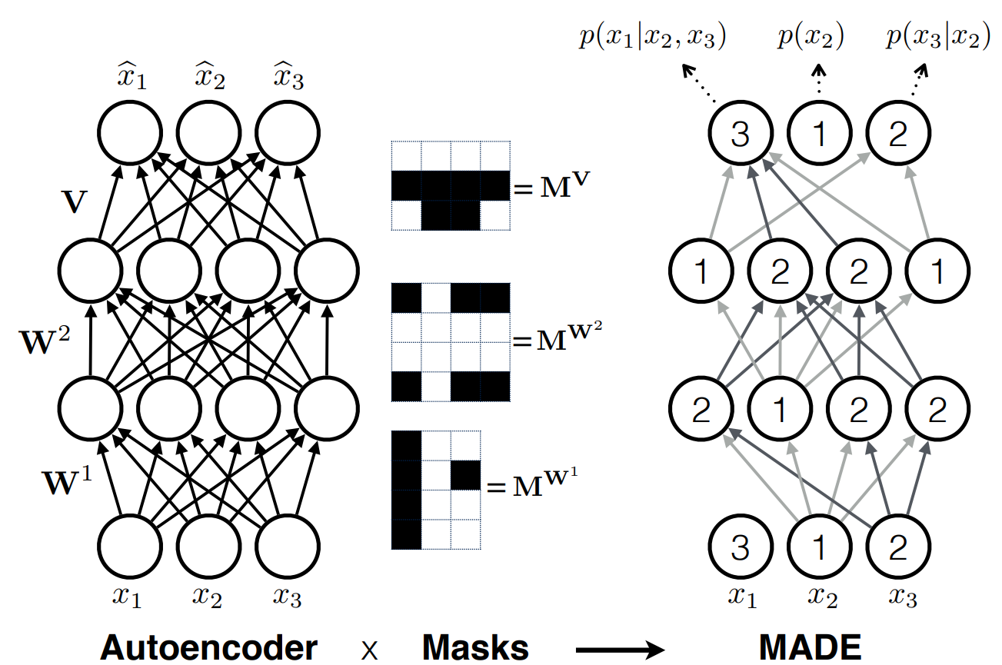
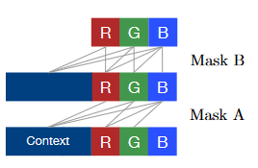
Goal: Erase all non-autoregressive connections (logically)
MADE vs PixelCNN: Masks
Masked out because they haven‘t been generated yet
Gruppe 1 Fachprojekt Machine Learning | Autoregressive Models
Notes:
Schwarz=0 -> connection fällt weg

Slide 6
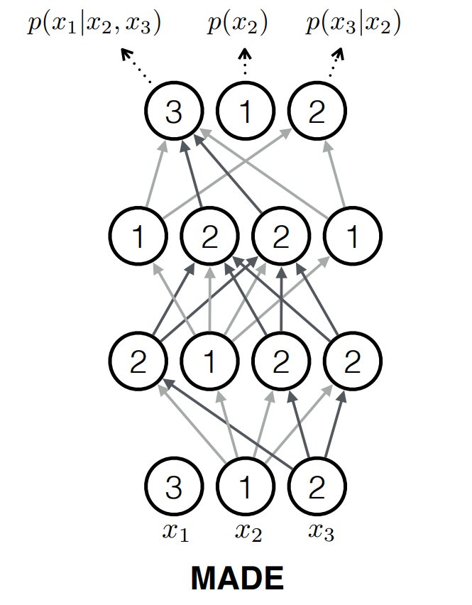
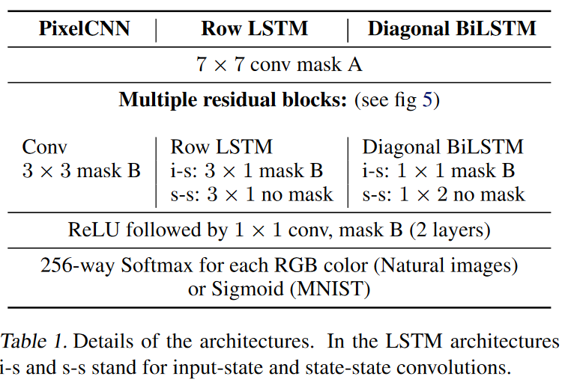
MADE vs PixelCNN: Structure
Gruppe 1 Fachprojekt Machine Learning | Autoregressive Models
Notes:
Schwarz=0 -> connection fällt weg

Slide 7
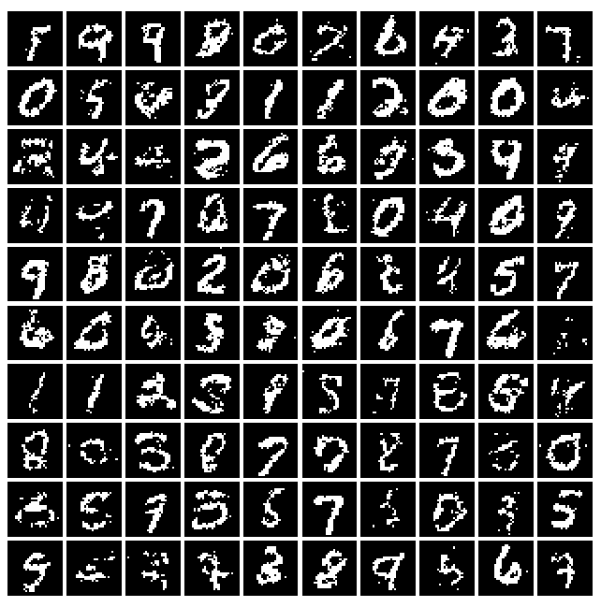
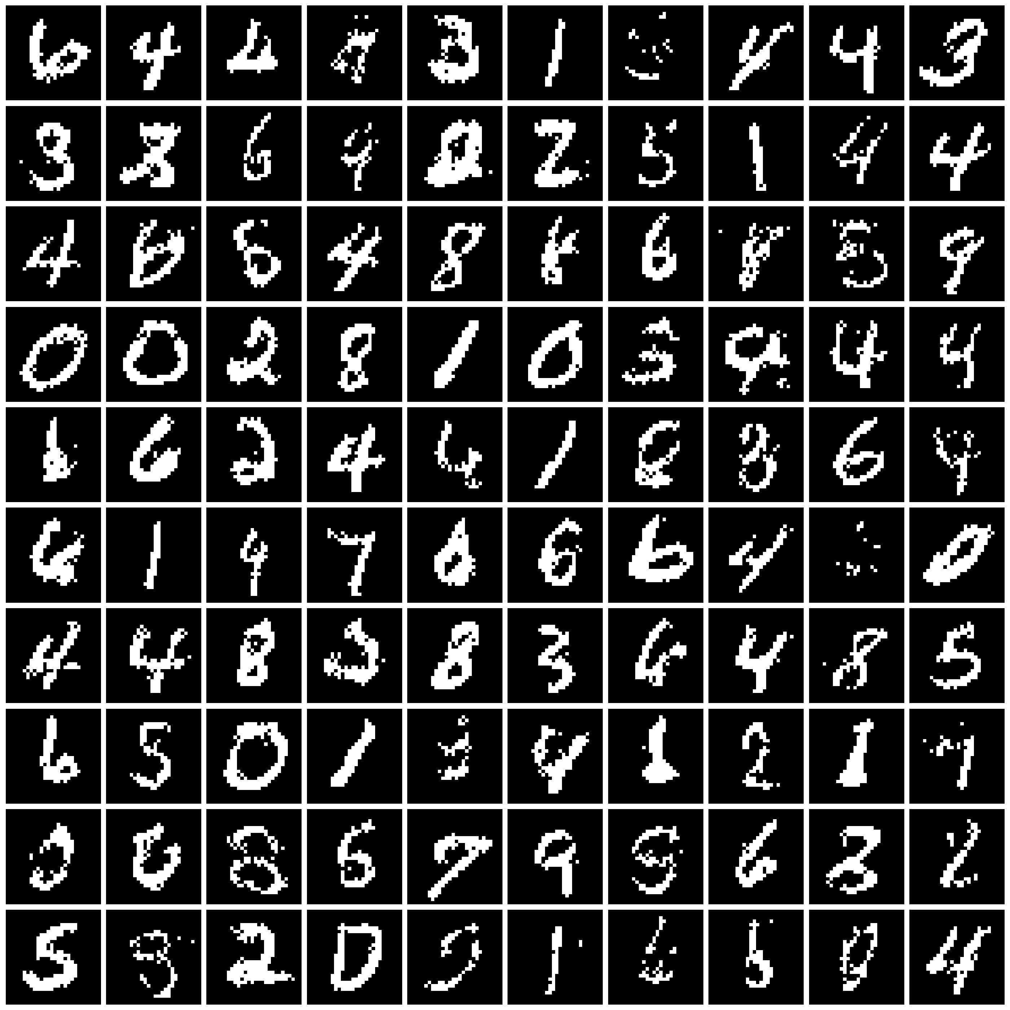
MADE samples
Samples from paper
Samples from us

Slide 8
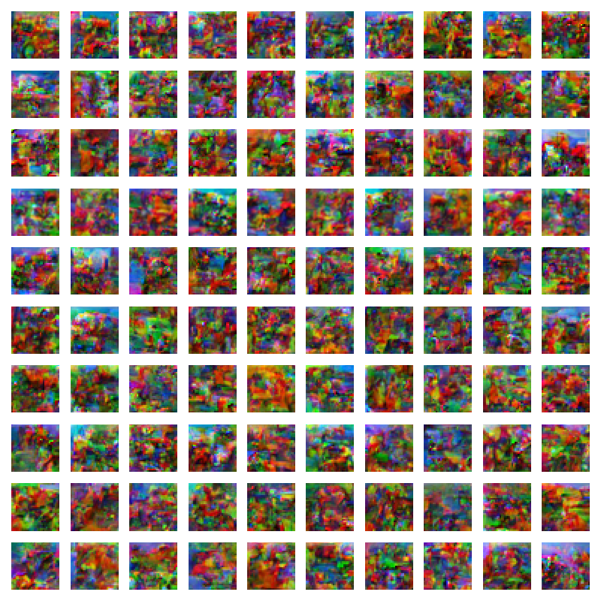
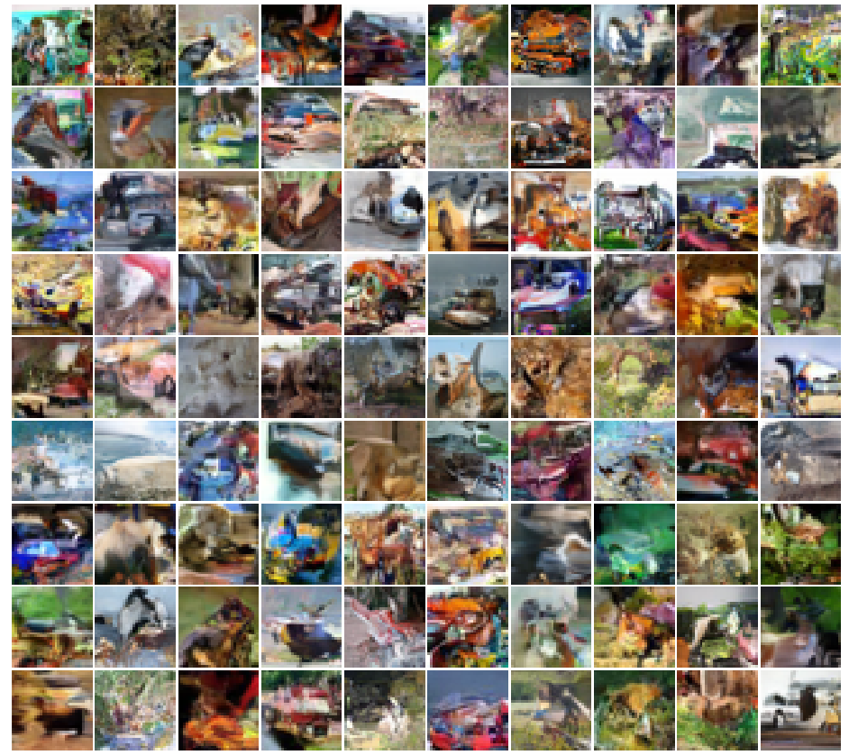
PixelCNN samples
Samples from paper
Samples from us

Slide 9
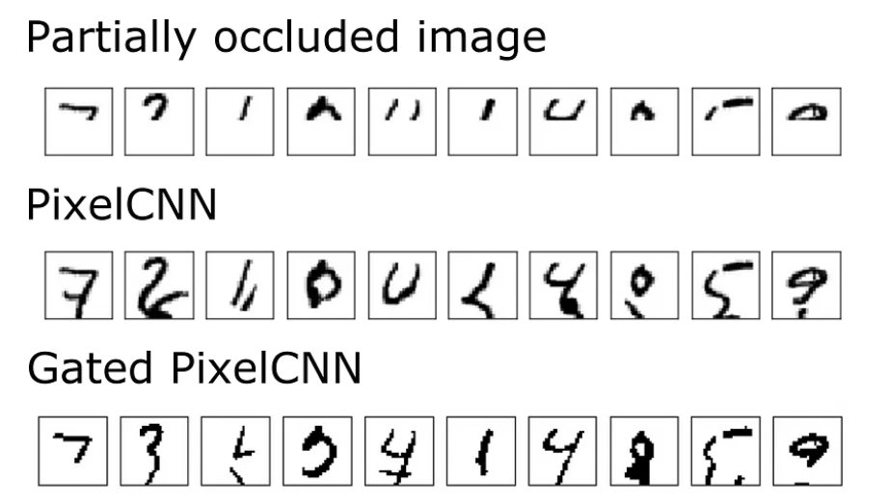
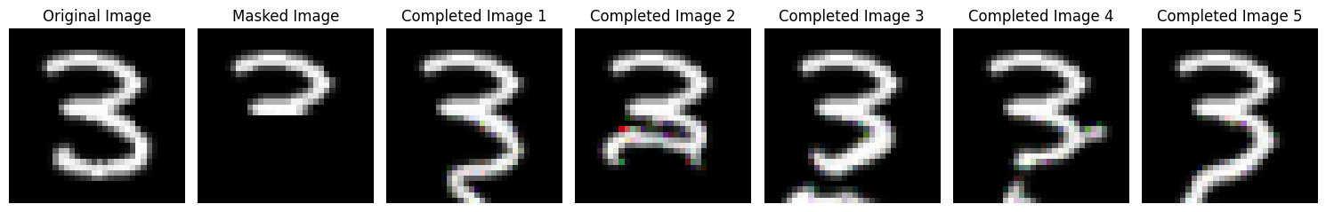
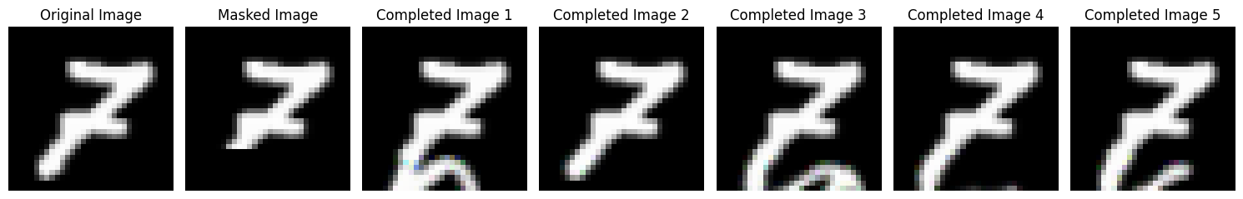
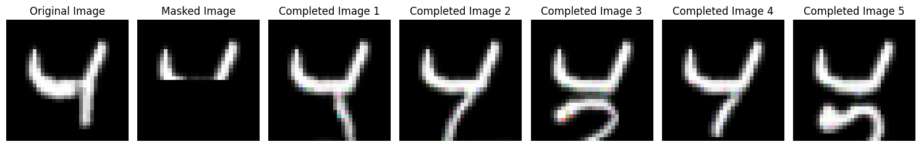
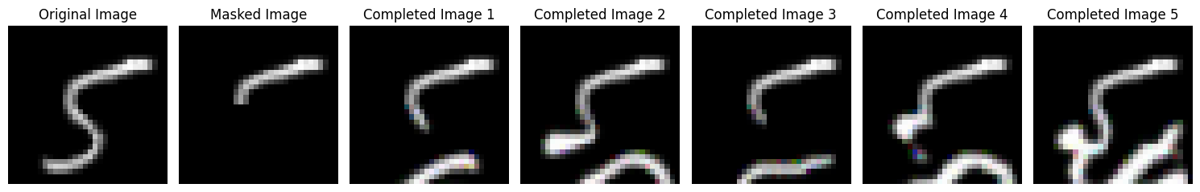
PixelCNN completions
Completions from
https://towardsdatascience.com/pixelcnns-blind-spot-84e19a3797b9
Completions from us

Slide 10
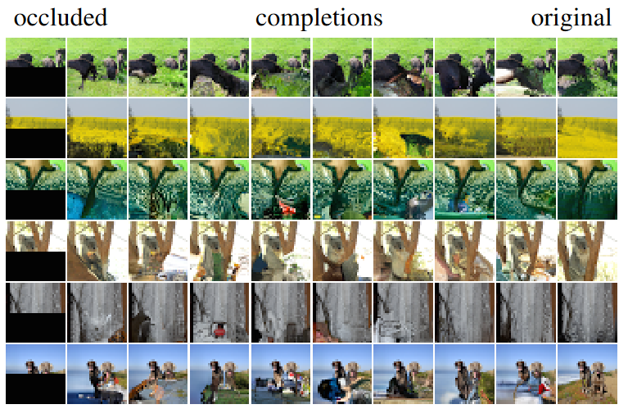
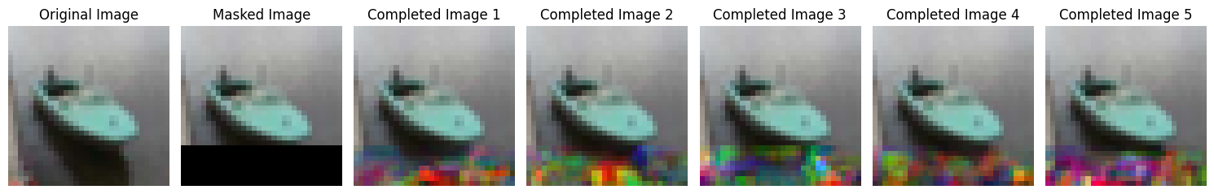
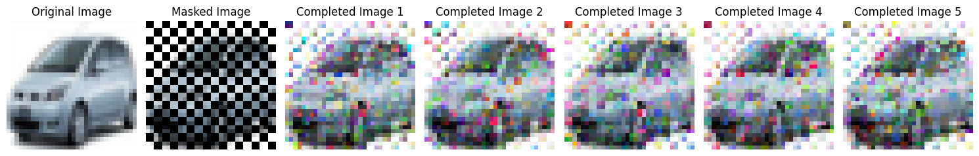
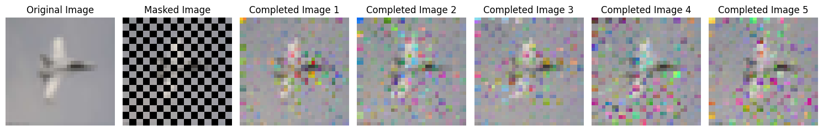
PixelCNN completions
Completions from paper
Completions from us

Slide 11
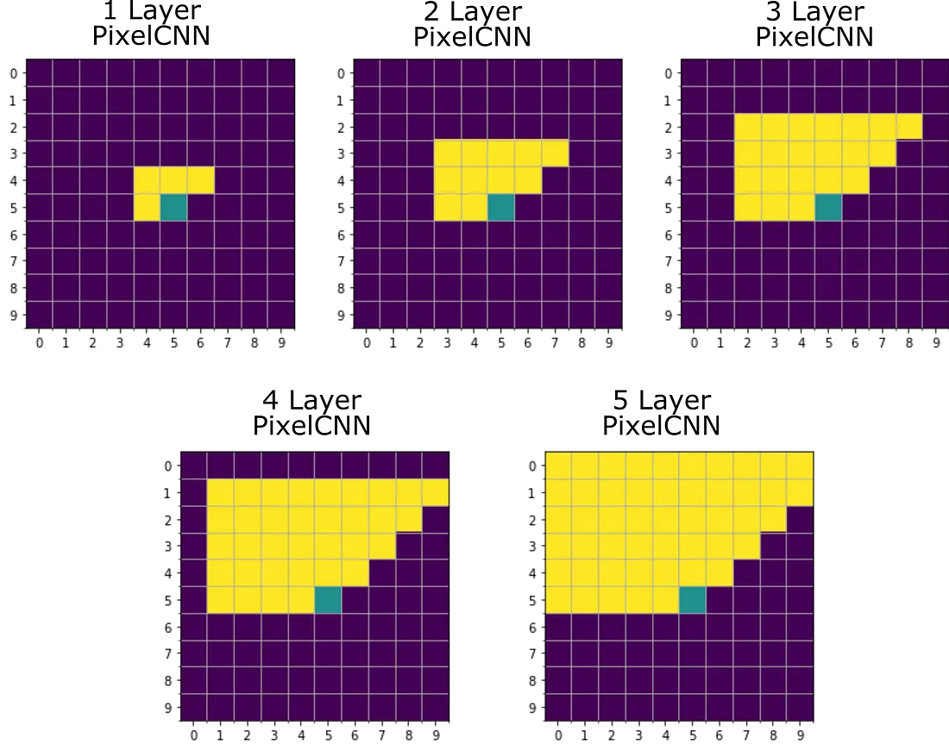
Problems
Autoregressive property of pictures is a problem in sampling
Mistakes in sampling accumulate over time
Blind spot problem (receptive field)
Sampling takes long time
https://miro.medium.com/v2/resize:fit:1100/format:webp/1*V0V1blD6mdGkPmYDede3dw.png

Slide 12
Appendix

Slide 13
Sources
Pixel Recurrent Neural Networks – Google DeepMind
MADE: Masked Autoencoder for Distribution Estimation - Mathieu Germain
https://medium.com
https://miro.medium.com
https://youtu.be/hfMk-kjRv4c?si=UGt55n13H9mIYcJa - Sebastian Lauge
https://youtu.be/tIeHLnjs5U8?si=5IEHnfWKft9AT6lP – 3Blue1Brown
MADE - blog by Kapil Sachdeva
https://bios691-deep-learning-r.netlify.app/class/04-class
https://neuroverse0.wordpress.com/2020/08/11/pixelrnn-gated-pixelcnn-and-pixelcnn
https://images.datacamp.com/image/upload/v1647442110/image2_ysmali.png
https://towardsdatascience.com/lstm-networks-a-detailed-explanation-8fae6aefc7f9
https://www.jeremyjordan.me/autoencoders
https://www.researchgate.net/figure/MLP-Autoencoder-architecture_fig4_373266879

